Slide 1


Chat Application In Java
EC321: jAva programing
(20EC074) Kousik Roy
(20EC076) MandeepSinh Sarvaiya
(20EC045) Vinayak Munet

Slide 2
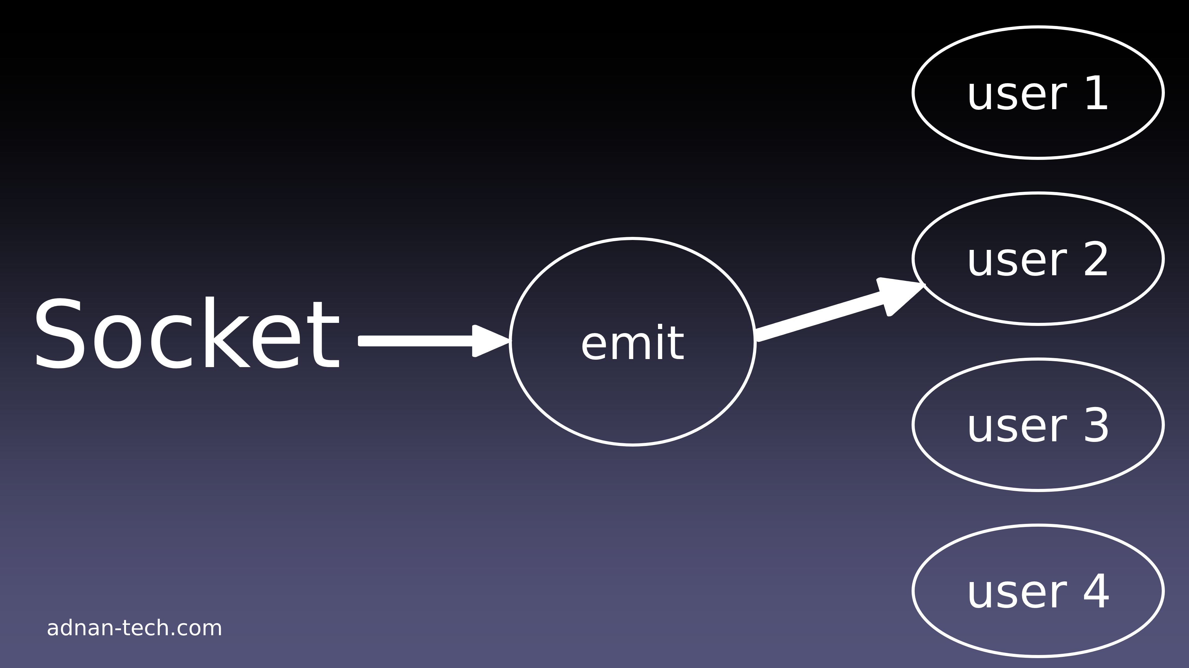
Introduction to Socket
The term socket programming refers to writing programs that execute across multiple computers in which the devices are all connected to each other using a network.
There are two communication protocols that one can use for socket programming :User datagram protocol(UDP)and Transfer control protocol(TCP).

Slide 3
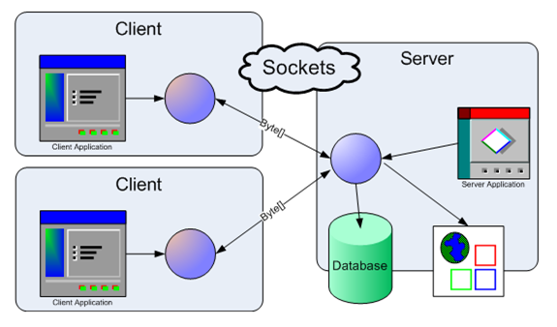
Server socket and client socket
A server socket keeps on listening to any incoming connections from any of the clients.
When you create a client socket, you simply specify the server address and port. You never bind or listen using a client socket.
You simply connect a client socket. On the other hand you dont connect using a server socket.

Slide 4
TCP/IP in Java
Accessing TCP/IP from java is Straightforward. The main functionality is in the following classes:
Java.net.InetAddress: Represents an IP address
IPV4or IPV6 and has methods for performing DNS lookup.
Java.net.Socket: Represents a TCP socket.
Java.net.ServerSocket: Represents a server socket which is capable of waiting for requests from clients.

Slide 5
TYPES OF SOCKET IN JAVA
Java provides three different types of sockets connection- oriented(TCP) sockets are implemented with the socket class.
Connectionless(UDP) sockets uses the Datagram Socket class. A third type is the Multicast Socket class, which is a subclass of the datagram Socket class.
Server
Client

Slide 6
TCP/IP SERVER SOCKETS
A socket in java is one endpoint of two-way communication link between two programs runnning on the network.
A socket is bound to a port number so that the TCP layer can identify the application that data is destined to be sent to.
An endpoint is a combination of an IP address and a port number.
This Server is locally created for the system.

Slide 7
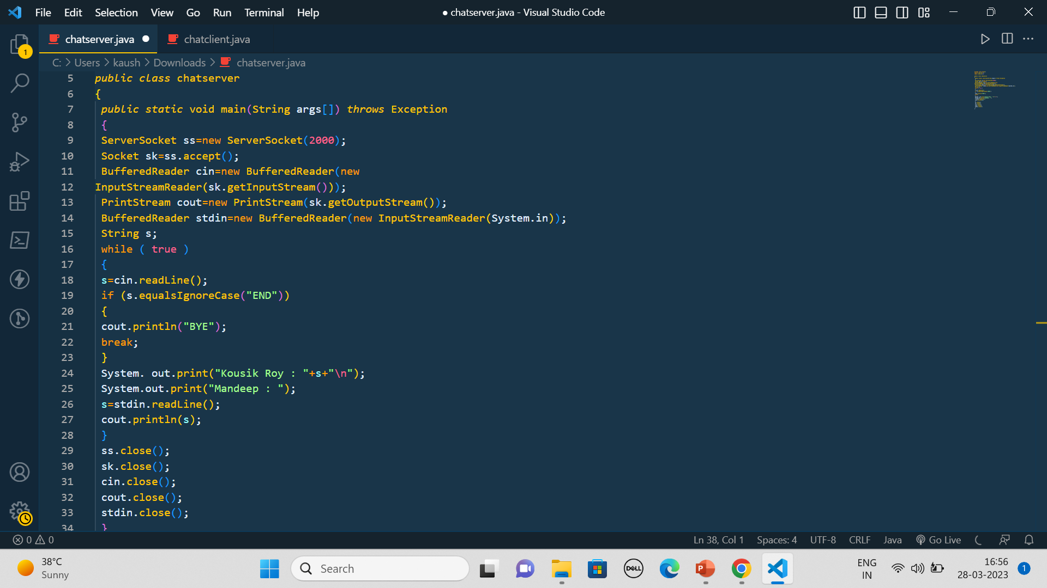
Server Example

Slide 8
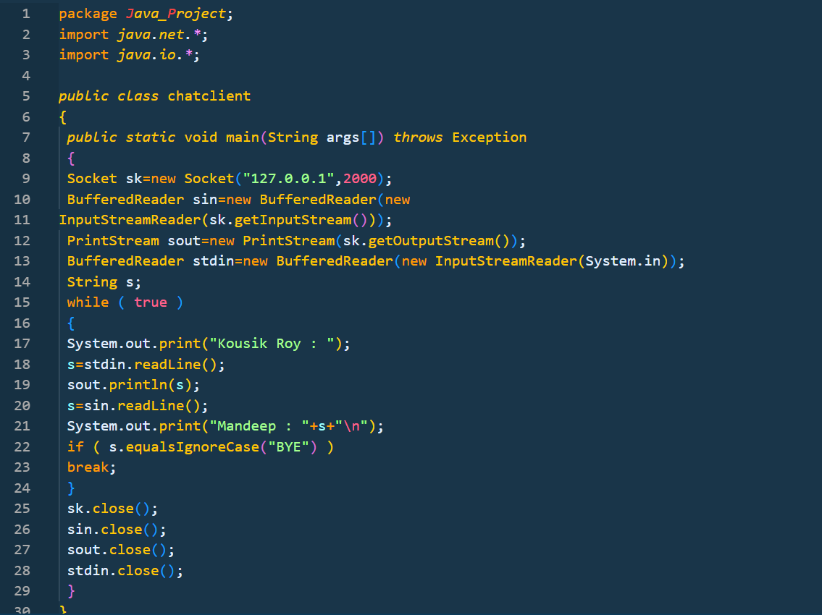
Client Example

Slide 9
Thank You!

